Slide 1
Costs, Demand, and Optimal Choice
Rajiv Sethi and the CORE Team

Slide 2
Overview
Fixed and variable costs
Total, average, and marginal costs
Demand and marginal revenue
Profit maximizing output
Deadweight loss
Reading: The Economy Units 7.3 to 7.7

Slide 3
Costs of Production

Slide 4
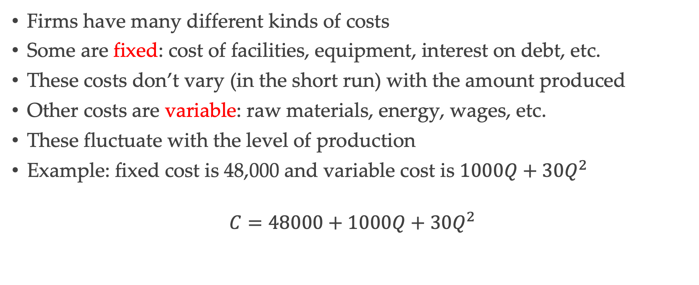
Fixed and Variable Cost
Firms have many different kinds of costs
Some are fixed: cost of facilities, equipment, interest on debt, etc.
These costs don’t vary (in the short run) with the amount produced
Other costs are variable: raw materials, energy, wages, etc.
These fluctuate with the level of production
Example: fixed cost is 48,000 and variable cost is ${1000Q+30Q}^{2}$
$$C=48000+1000Q+30Q^{2}$$

Slide 5
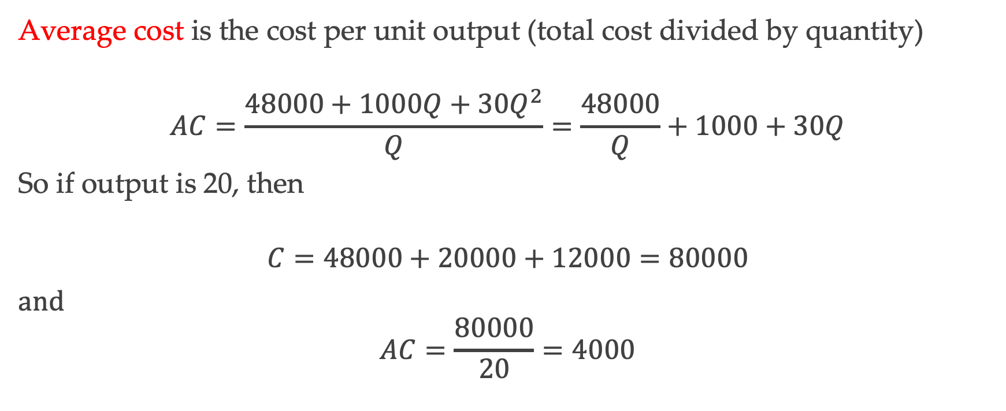
Average Cost
Average cost is the cost per unit output (total cost divided by quantity)
$$AC=\frac{48000+1000Q+30Q^{2}}{Q}=\frac{48000}{Q}+1000+30Q$$
So if output is 20, then
$$C=48000+20000+12000=80000$$
and
$$AC=\frac{80000}{20}=4000$$

Slide 6
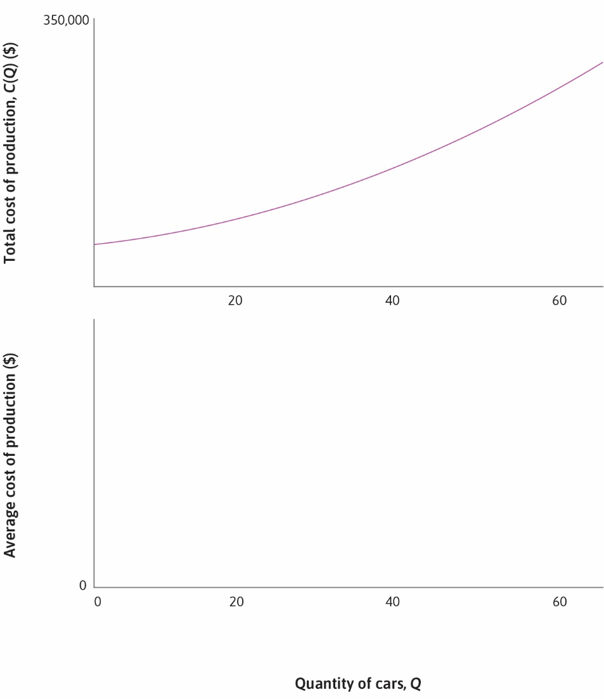

Slide 7


Slide 8


Slide 9
Average Cost (continued)
Average cost is slope of line from origin to point on total cost curve
In this example, AC falls initially, reaches minimum, then starts to rise
AC reaches minimum at point of tangency (point B on next slide)
Here quantity is 40 and average cost is 3,400

Slide 10
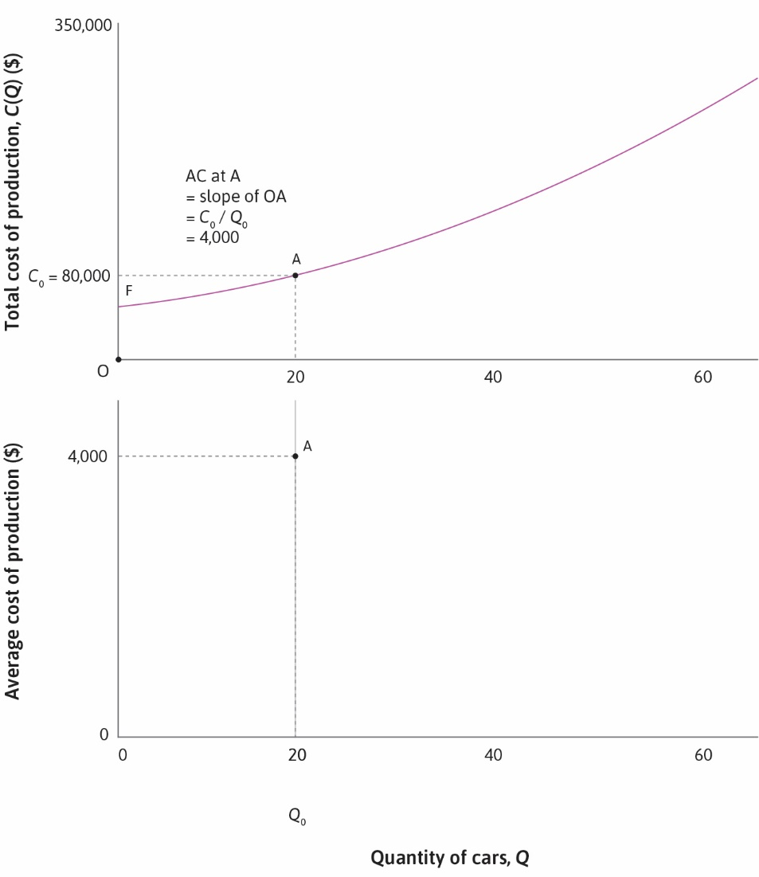

Slide 11
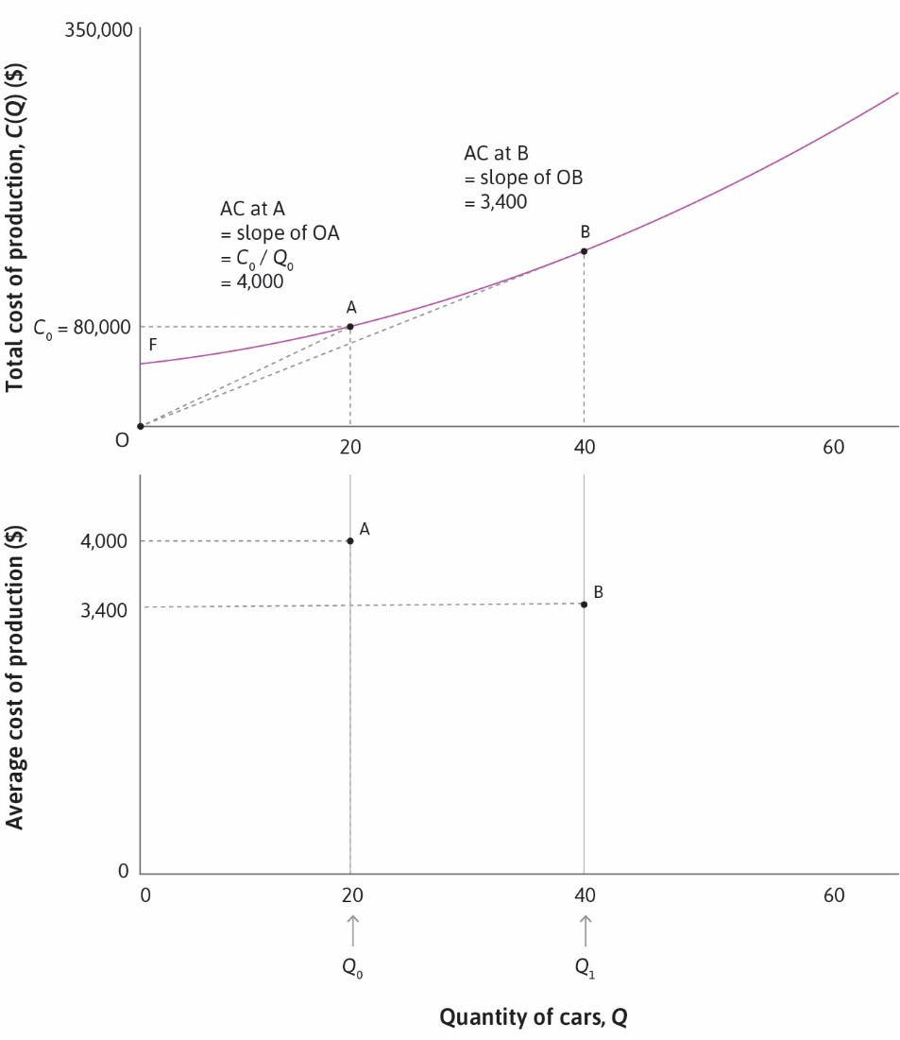

Slide 12
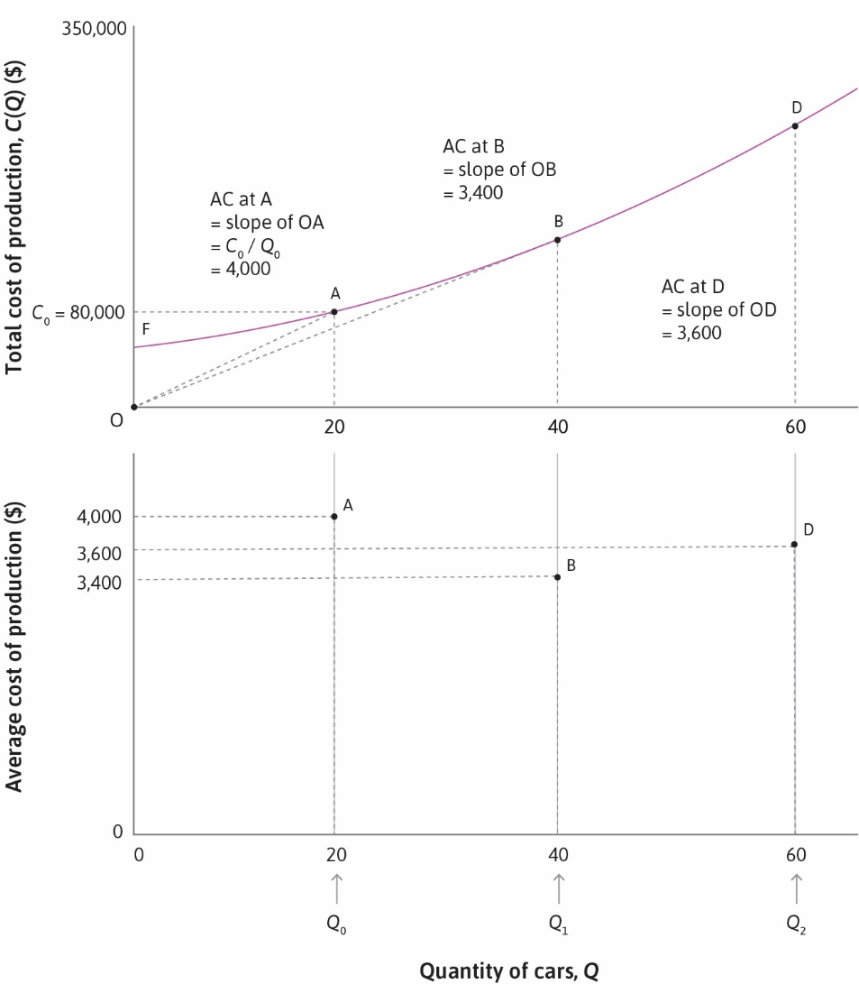

Slide 13
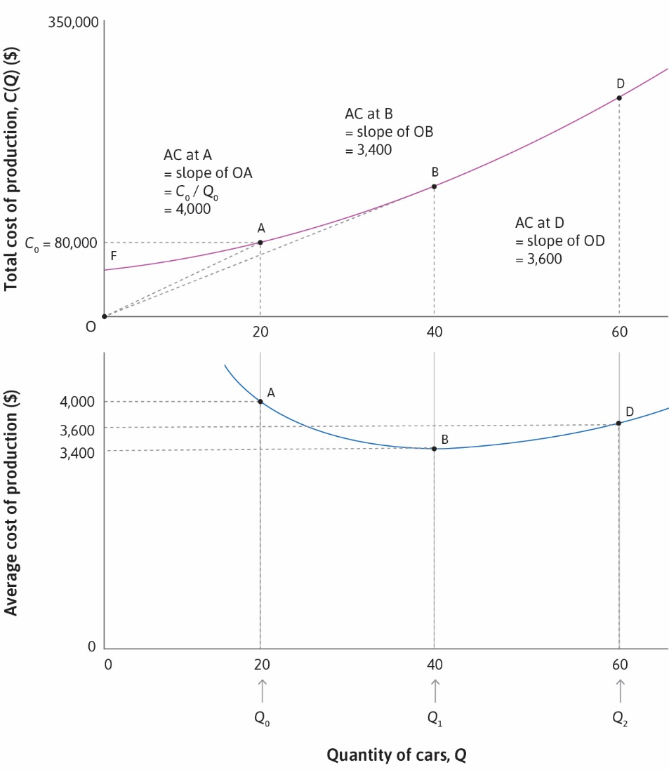

Slide 14
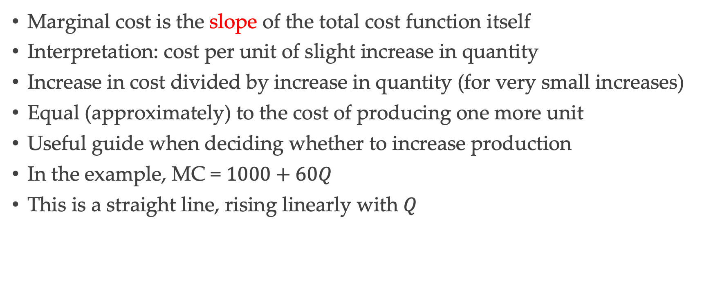
Marginal Cost
Marginal cost is the slope of the total cost function itself
Interpretation: cost per unit of slight increase in quantity
Increase in cost divided by increase in quantity (for very small increases)
Equal (approximately) to the cost of producing one more unit
Useful guide when deciding whether to increase production
In the example, MC = $1000+60Q$
This is a straight line, rising linearly with $Q$

Slide 15
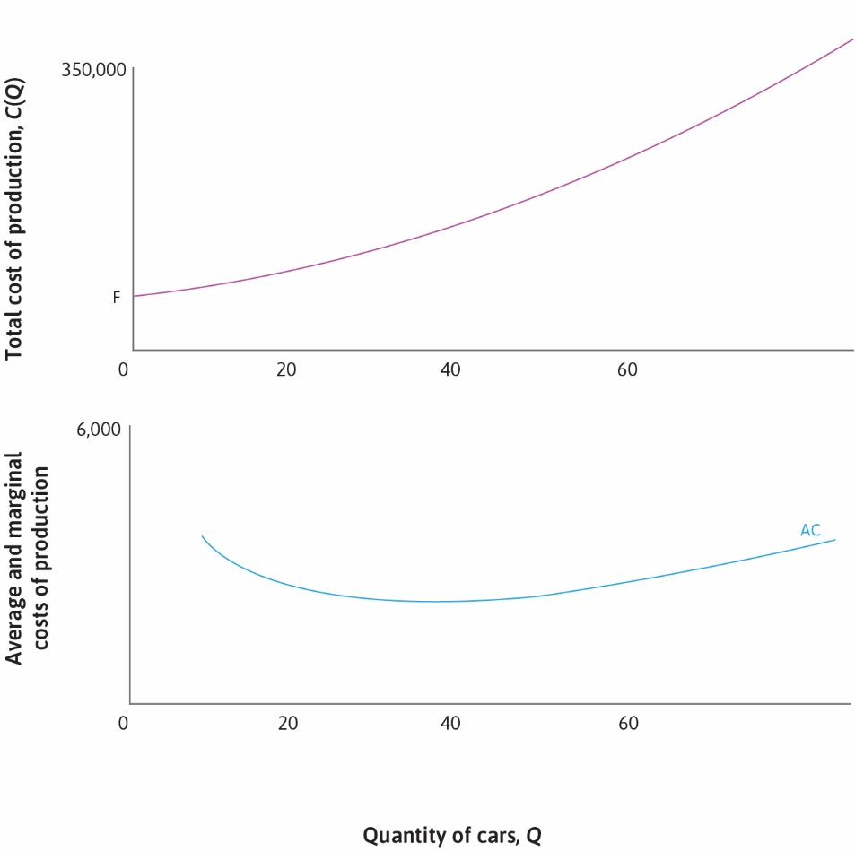

Slide 16
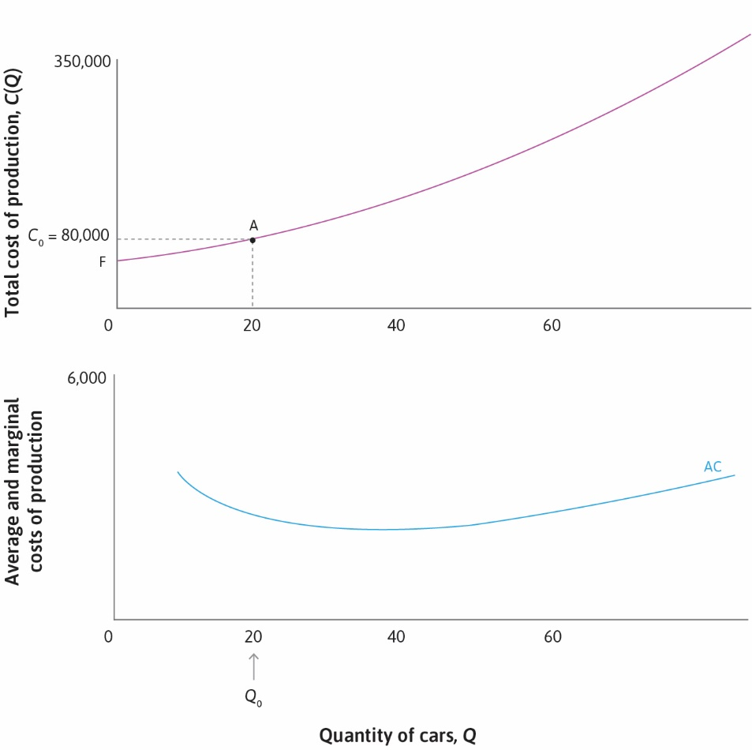

Slide 17
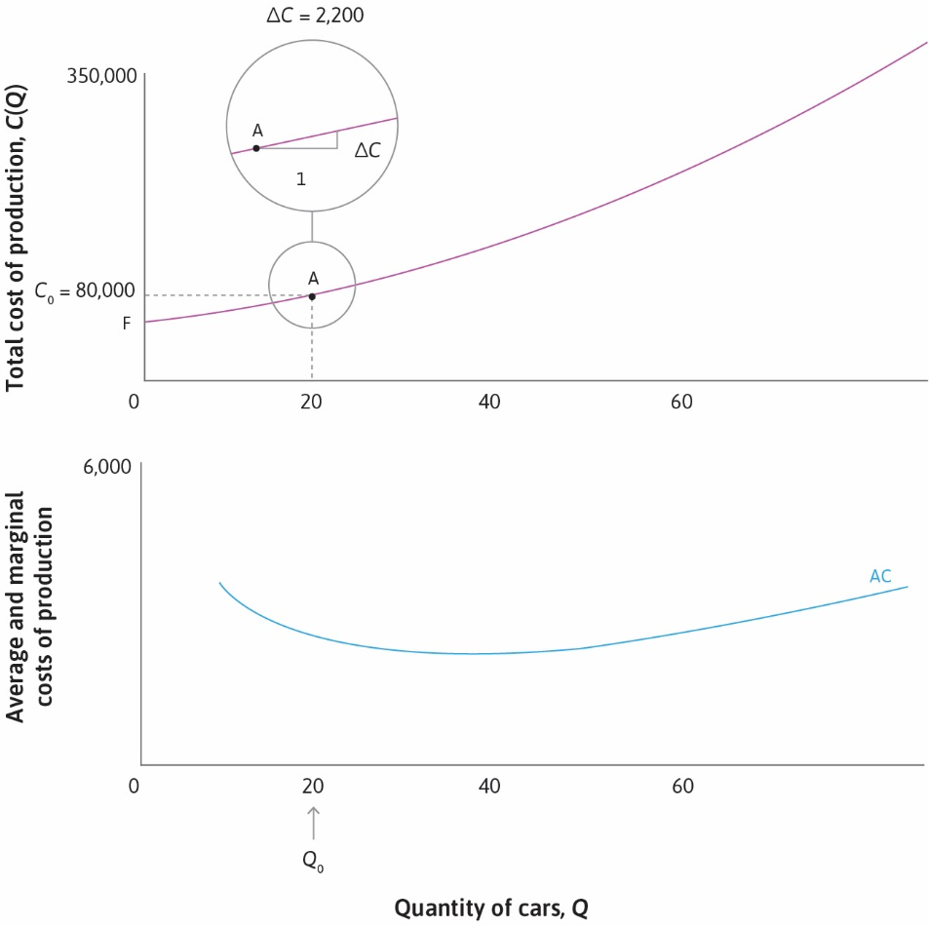

Slide 18
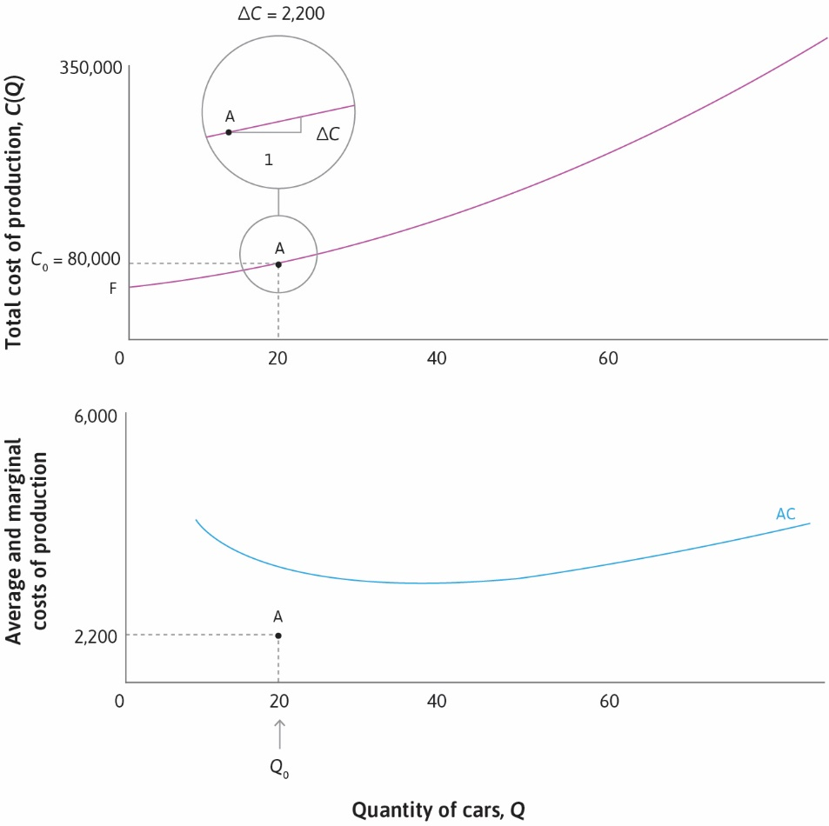

Slide 19


Slide 20


Slide 21


Slide 22
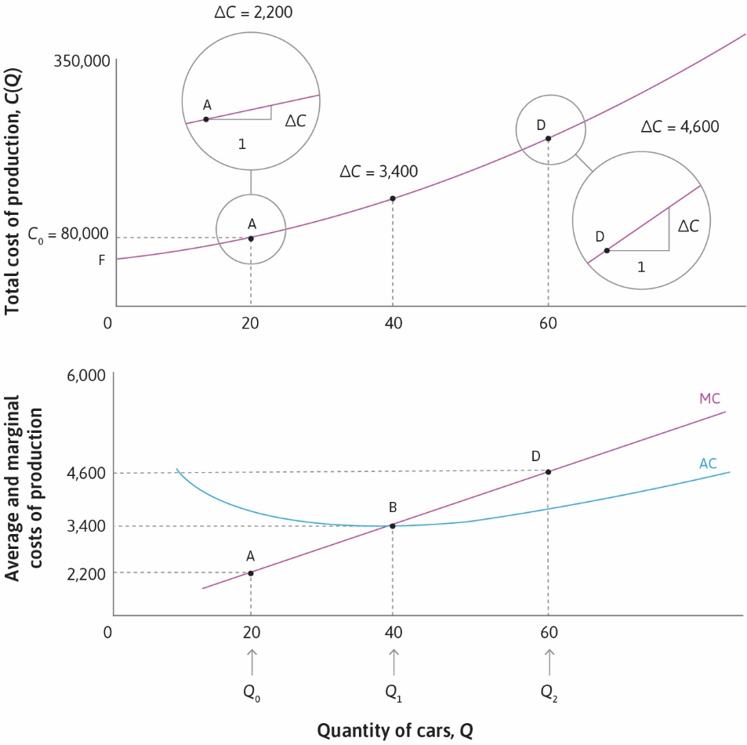

Slide 23
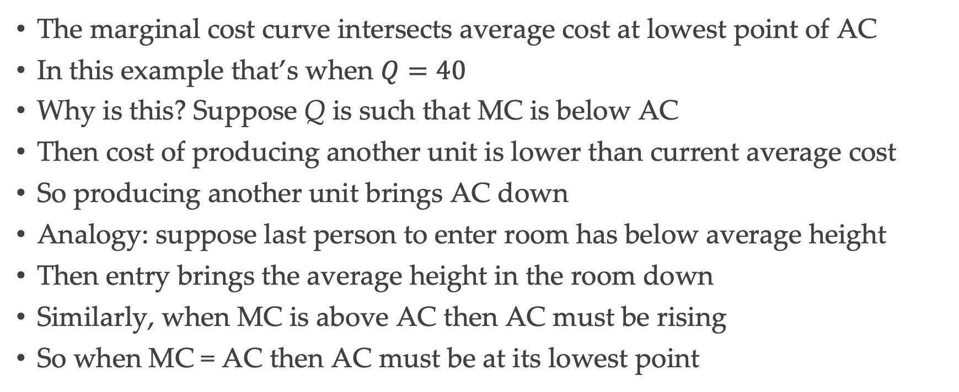
Average and Marginal Cost
The marginal cost curve intersects average cost at lowest point of AC
In this example that’s when $Q=40$
Why is this? Suppose Q is such that MC is below AC
Then cost of producing another unit is lower than current average cost
So producing another unit brings AC down
Analogy: suppose last person to enter room has below average height
Then entry brings the average height in the room down
Similarly, when MC is above AC then AC must be rising
So when MC = AC then AC must be at its lowest point

Slide 24
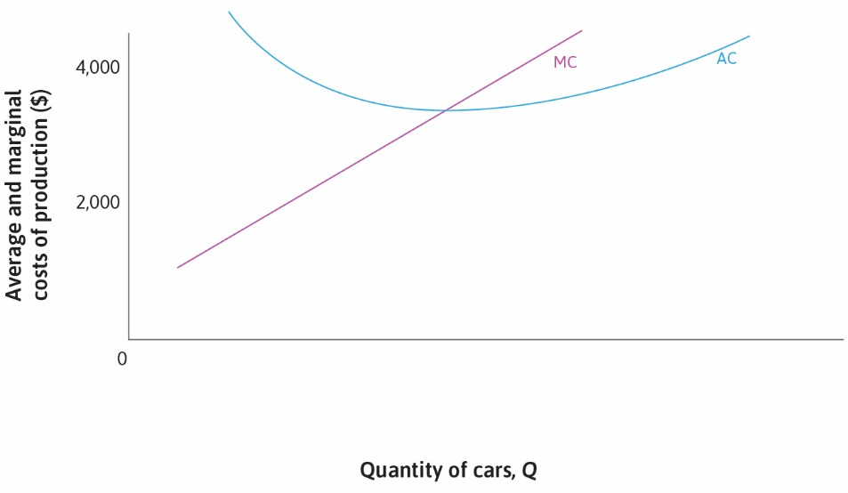

Slide 25


Slide 26
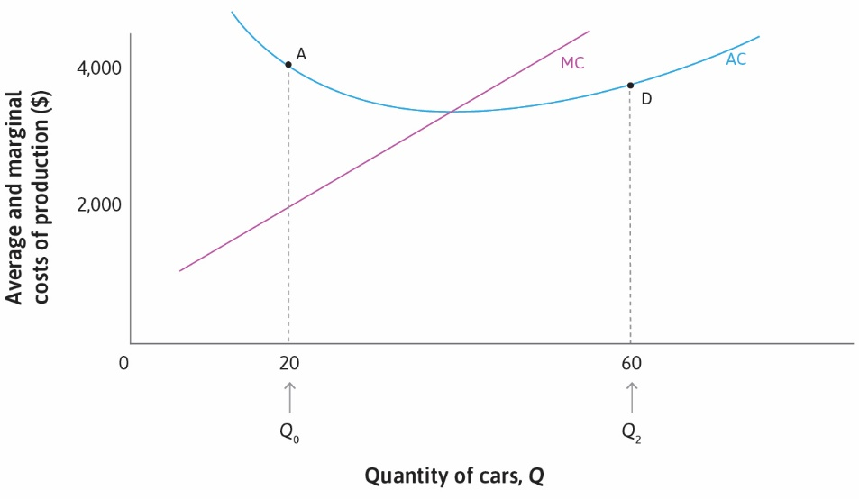

Slide 27


Slide 28
Profit
Recall: profit is total revenue minus total cost
Total cost is just average cost multiplied by quantity
And total revenue is price multiplied by quantity
So profit is (P – AC)Q
For any given Q, if P is set to equal AC, profit will be zero
This gives us the zero profit isoprofit curve
So the AC curve is also the zero profit isoprofit curve
All positive profit isoprofit curves lie above this

Slide 29
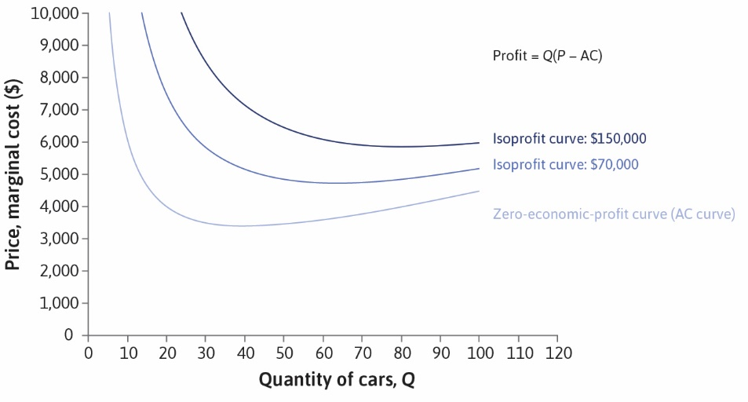

Slide 30
Profit
Suppose production is at point G (next slide)
Vertical distance from G to zero isoprofit curve is P – AC
This is profit per unit output, need to multiply by Q to get total profit
So the area of rectangle to the vertical axis (next slide) is total profit
In this case happens to be $70,000
Point K yields same profit but with more sales, lower price, higher AC
But neither of these points may be feasible
Need to look at demand curve (feasible frontier)

Slide 31
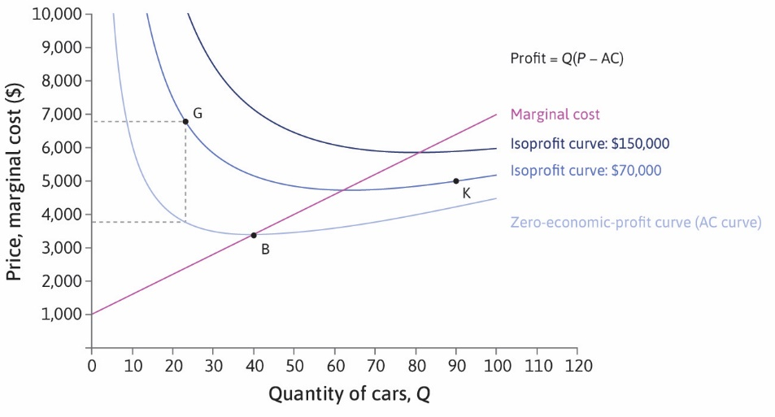

Slide 32
Optimal Choice
Recall: to maximize profit, choose highest feasible isoprofit curve
Demand curve determines what is feasible
Optimal choice is at tangency point (point E on next slide)

Slide 33
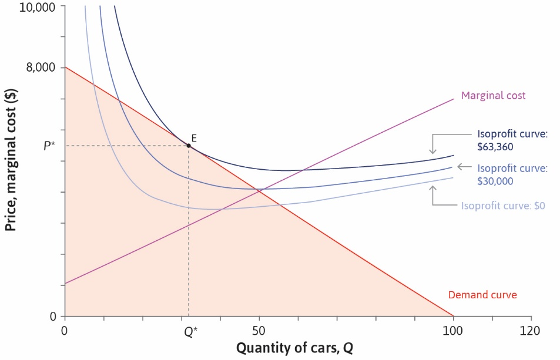

Slide 34
Marginal Revenue
Another way to think about profit maximization
Marginal revenue equated to marginal cost
What is marginal revenue?
Additional revenue per unit output obtained by increasing output a bit
But increasing output requires reducing price on all units
So more is sold, but at a lower price, and revenue may go up or down
Example: suppose output is at 20, consider raising it to 21 (next slide)
There is a loss and a gain; marginal revenue is the gain minus loss

Slide 35
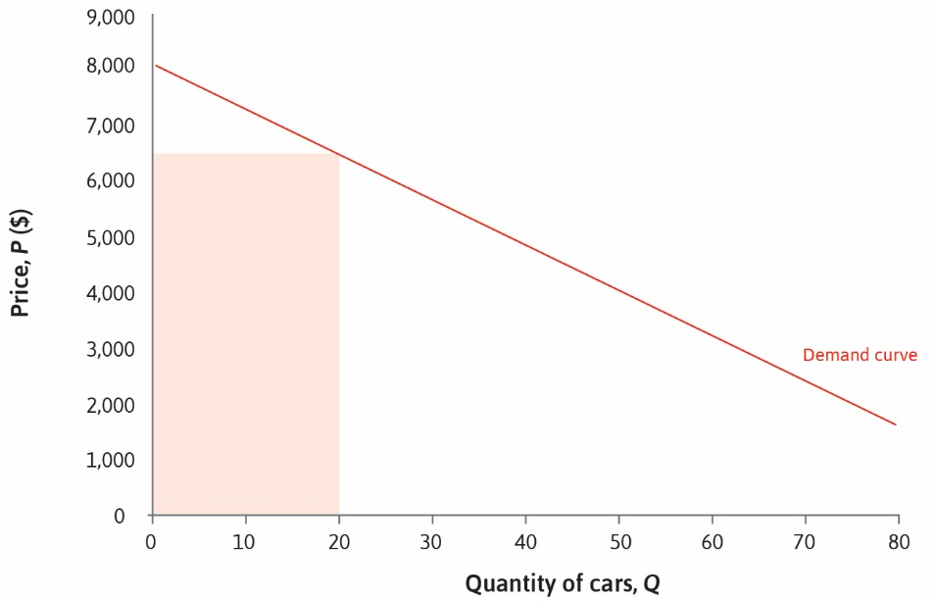

Slide 36
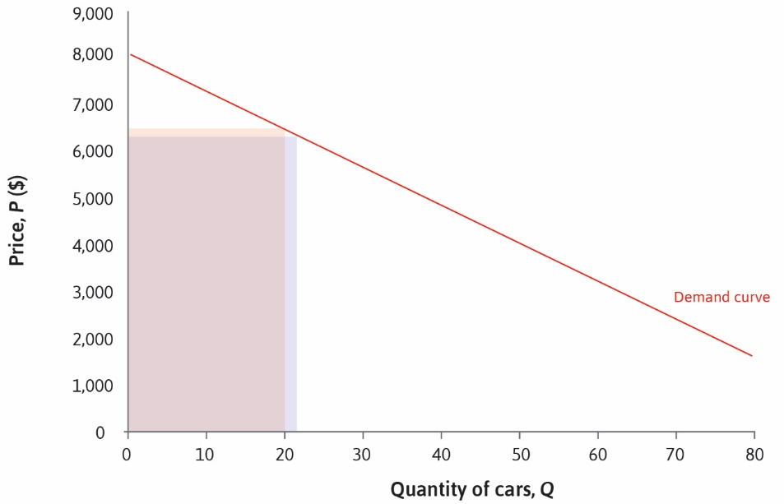

Slide 37
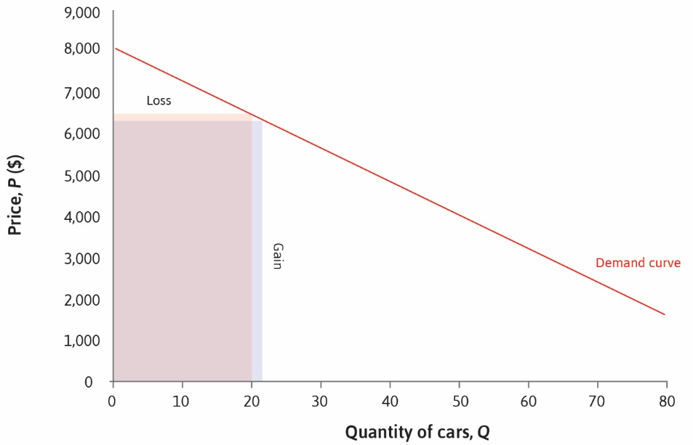

Slide 38
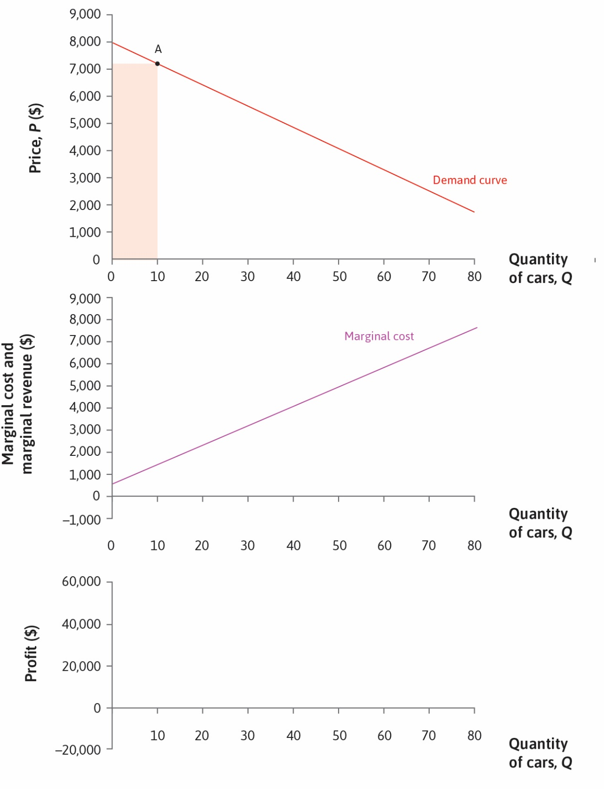

Slide 39
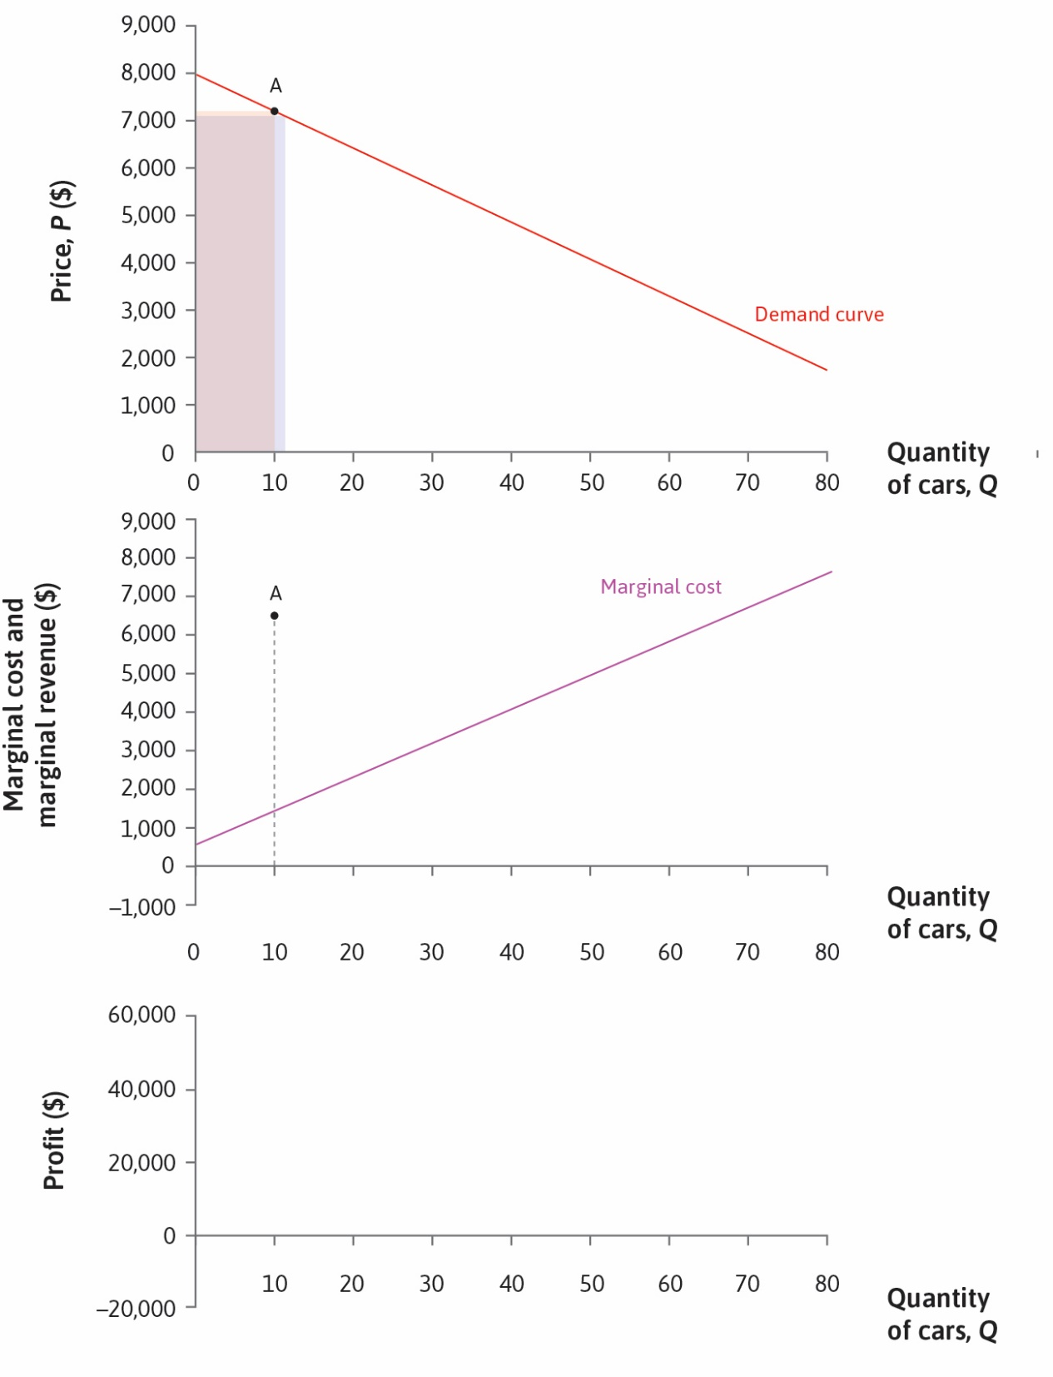

Slide 40
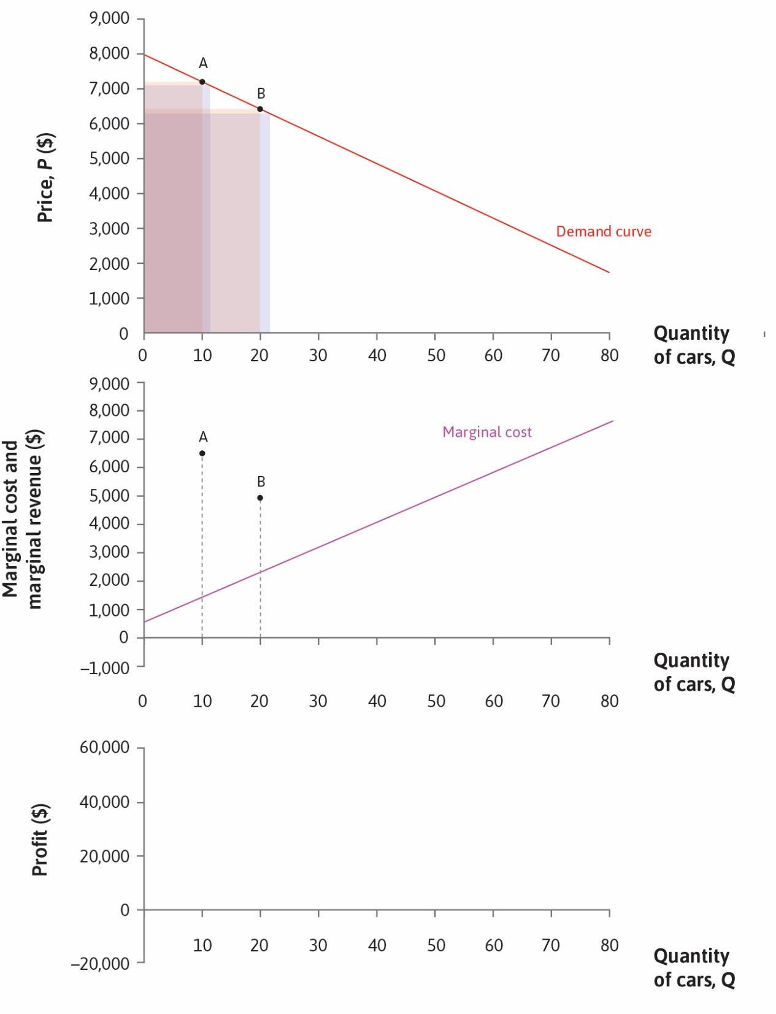

Slide 41
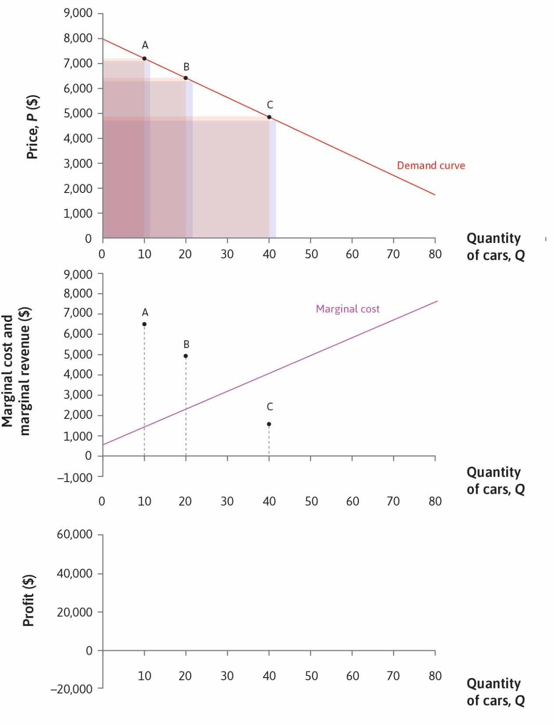

Slide 42
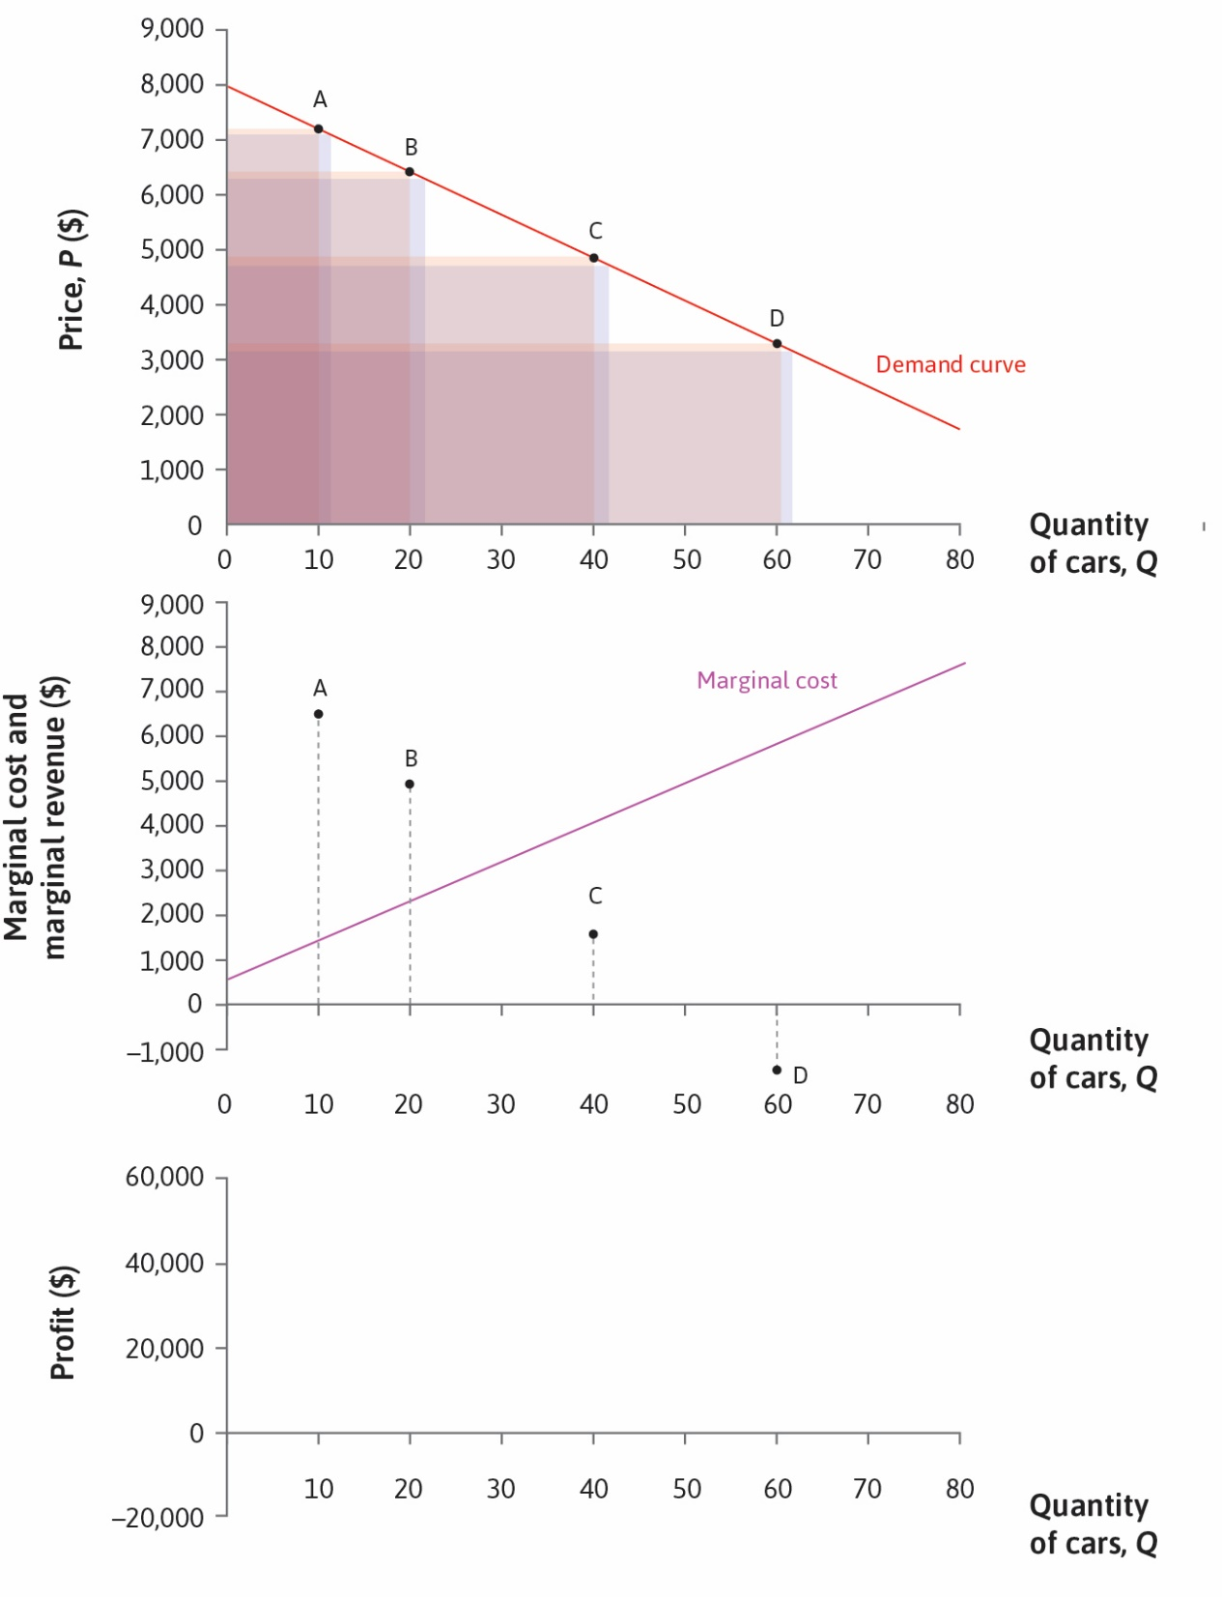

Slide 43
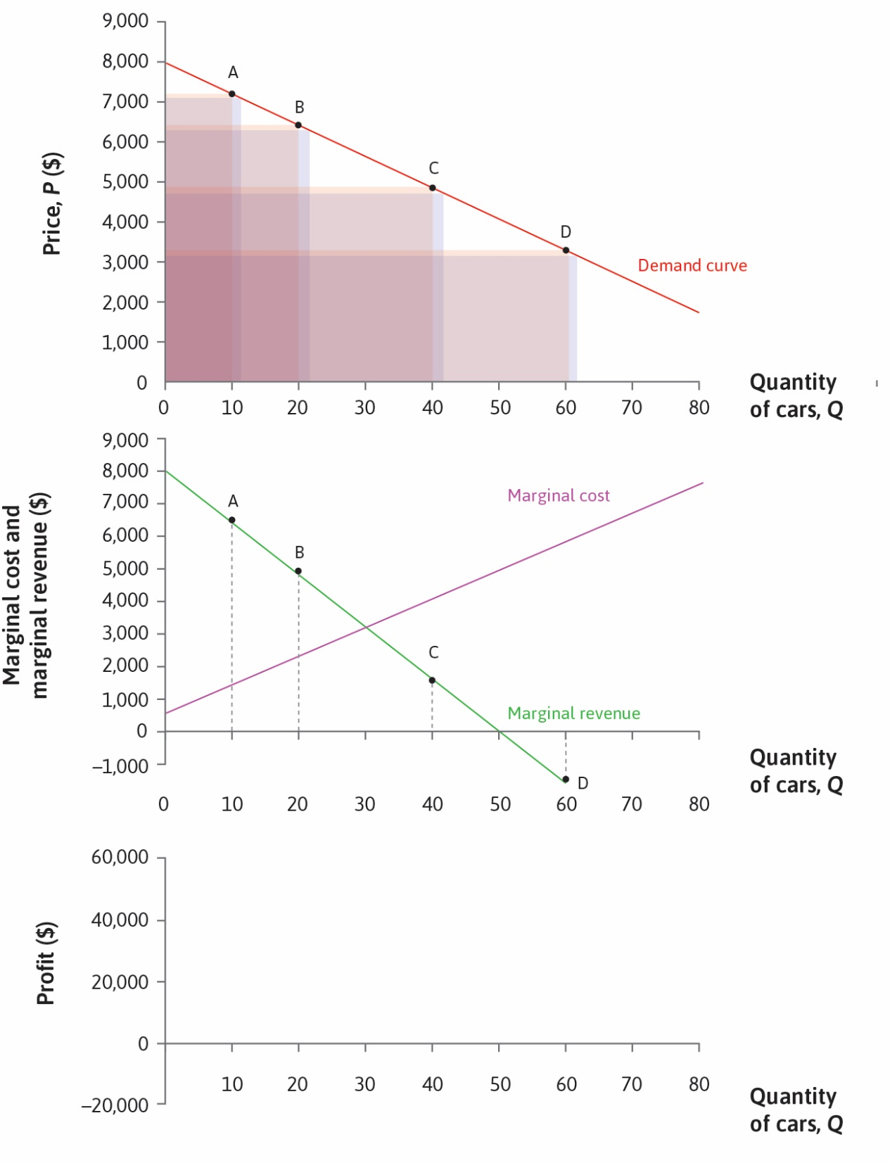

Slide 44


Slide 45
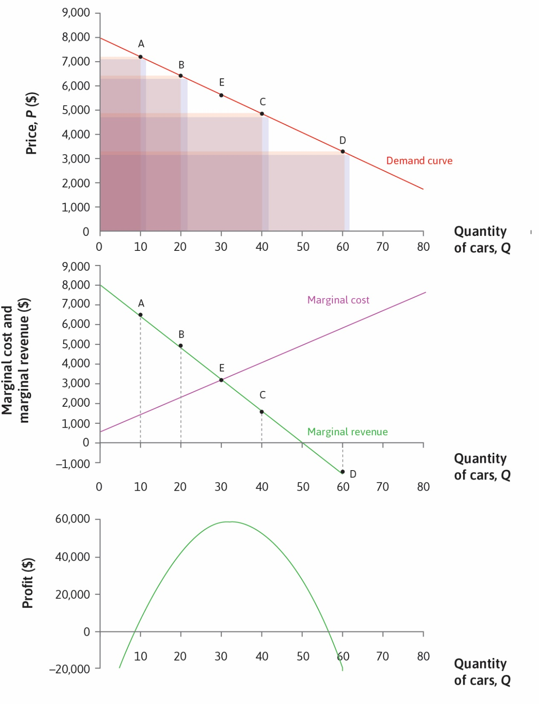

Slide 46
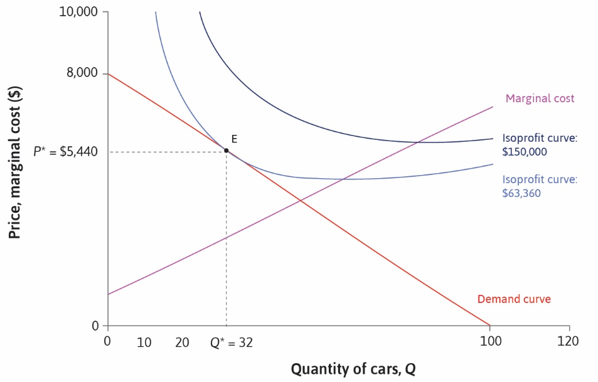

Slide 47
Consumer Suplus
Demand curve shows what consumers are willing to pay
Price is what they actually play
The difference is consumer surplus
Geometrically the area of triangle above price and below demand

Slide 48
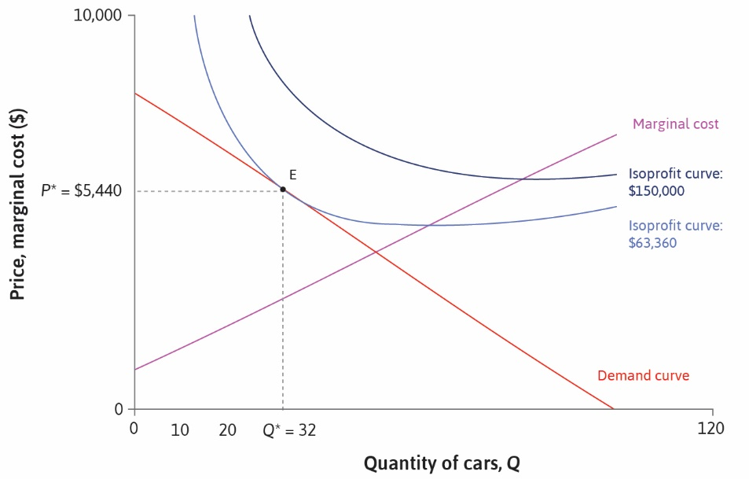

Slide 49


Slide 50
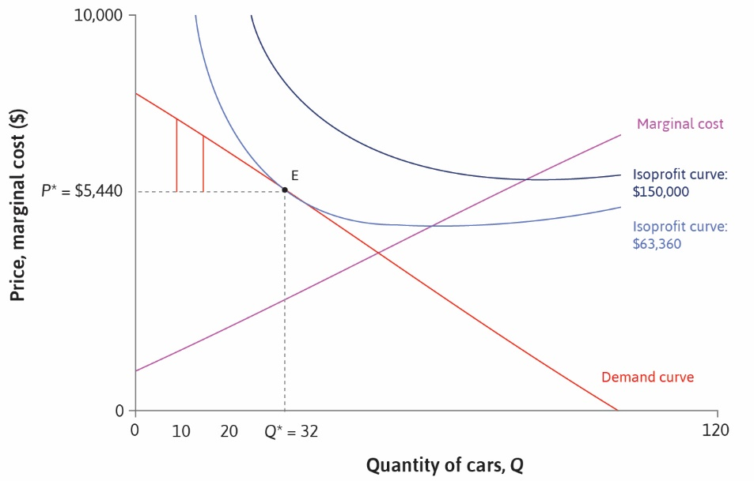

Slide 51
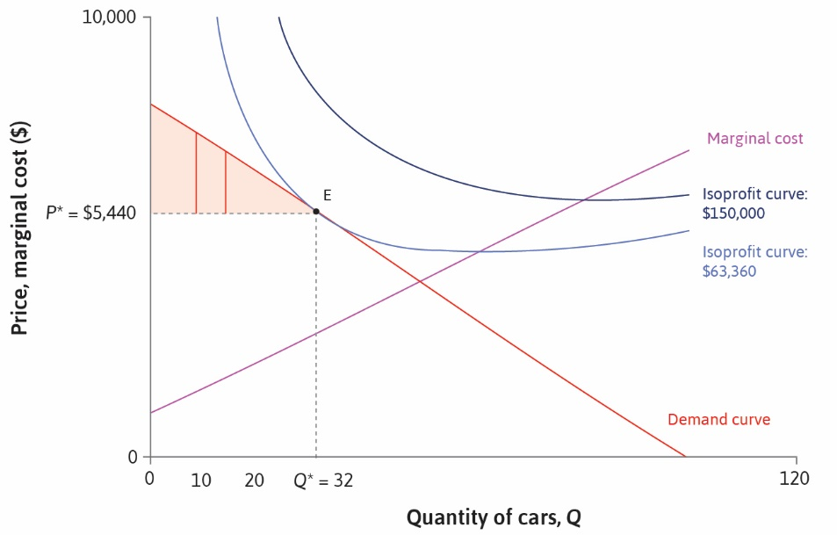

Slide 52
Producer Surplus
For each unit produced and sold, firm gets the price
Cost of production is the marginal cost
Difference is profit or producer surplus
Geometrically: area of region below price and above marginal cost

Slide 53
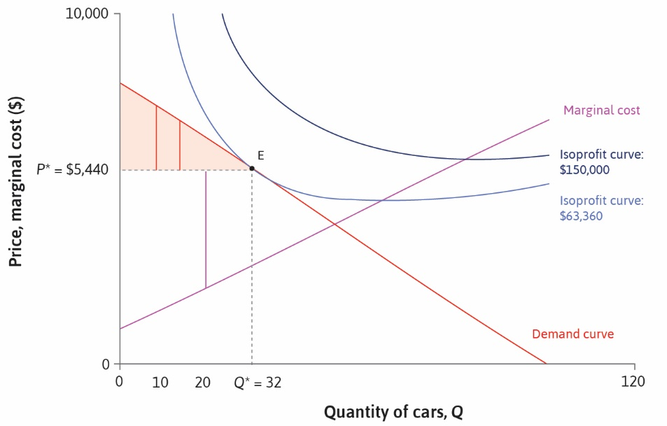

Slide 54
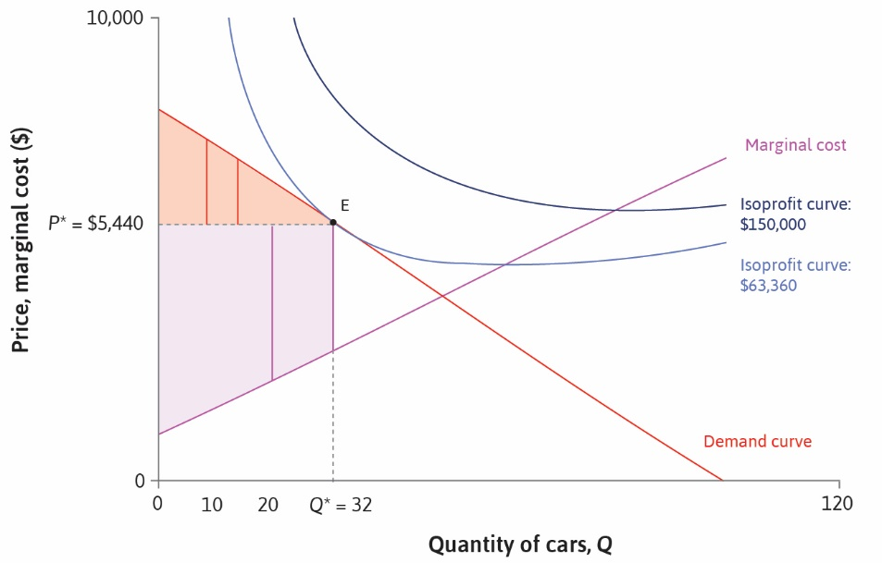

Slide 55
Deadweight Loss
Notice that price is higher than marginal cost
Raising quantity by one unit costs less than consumers are willing to pay
The optimal choice is not Pareto-efficient
Why does the firm not raise quantity?
It would have to cut price for all consumers, not just additional ones
As a result, some mutually beneficial transactions are not made
Resulting in a deadweight loss

Slide 56
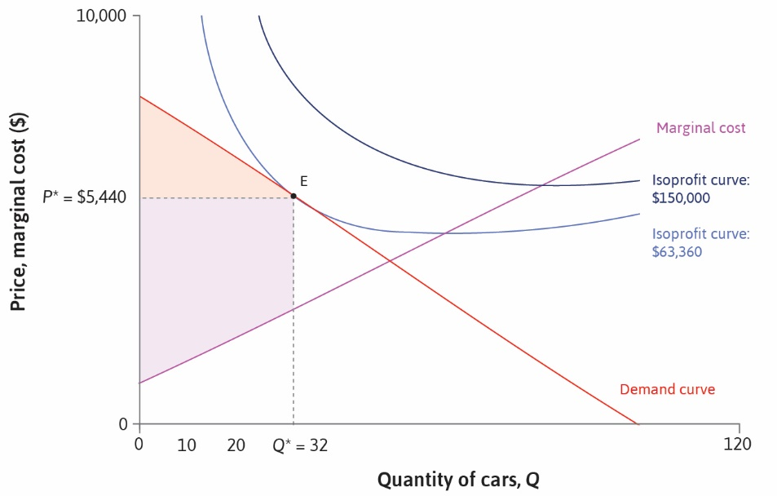

Slide 57
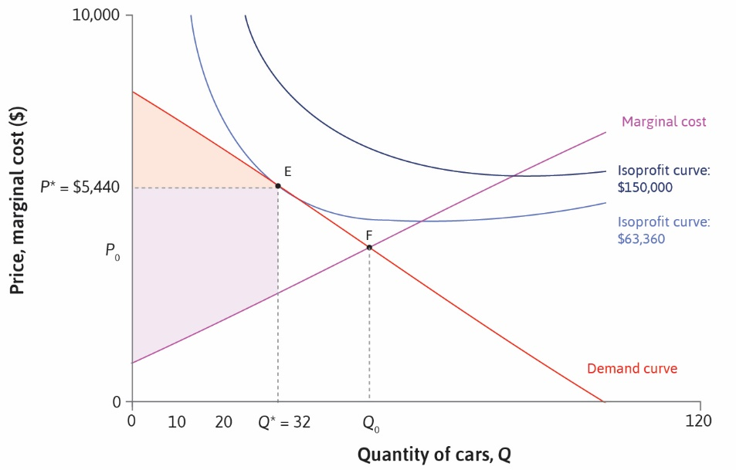

Slide 58
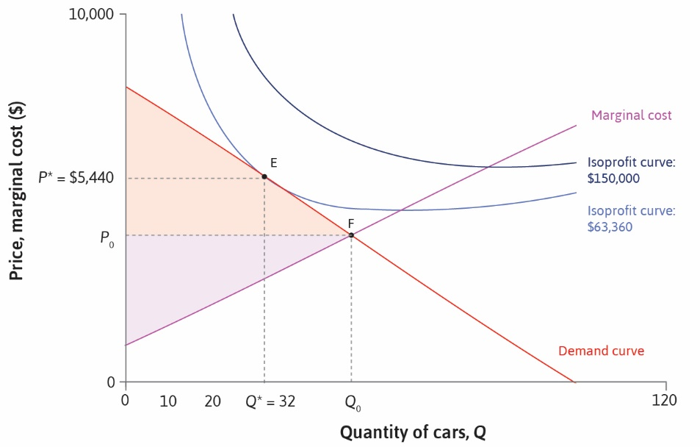

Slide 59


